Slide 1
Lecture-3:
Review of required digital signal processing

Slide 2
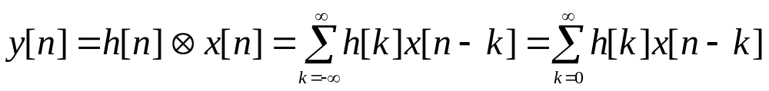
Convolution
Convolution is one of the most frequently used operations in DSP. Specially in digital filtering applications where two finite and causal sequences x[n] and h[n] of lengths N₁ and N₂ are convolved

Slide 3
Operations involved
Folding
Shifting
Multiplication
Summation
ES & BM
Signal Processing

Slide 4
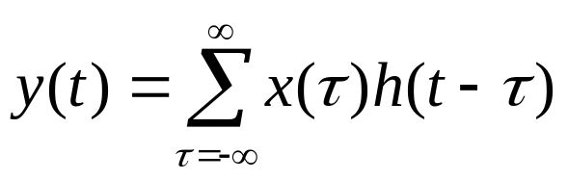
h(τ)
τ
x(τ)
τ
y(t)
t

Slide 5
h(-τ)
τ
x(τ)
τ
y(t)
t

Slide 6
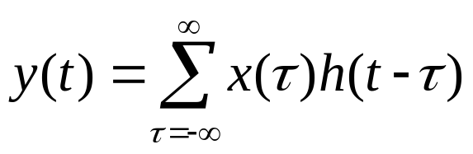
h(t-τ), t=0
τ
x(τ)
τ
y(t)
t

Slide 7
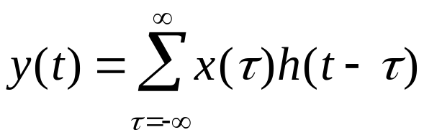
h(t-τ), t=1
τ
x(τ)
τ
y(t)
t

Slide 8
h(t-τ),t=2
τ
x(τ)
τ
y(t)
t

Slide 9
h(t-τ),t=5
τ
x(τ)
τ
y(t)
t

Slide 10
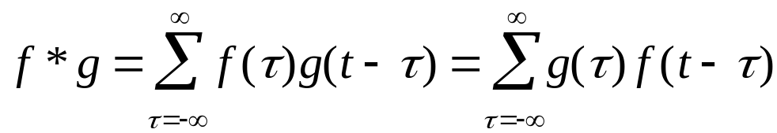
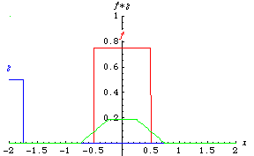
Example convolutions
The sum of the product of 2 functions after 1 is reversed & shifted.
Convolution of two rectangles
http://mathworld.wolfram.com/Convolution.html

Slide 11
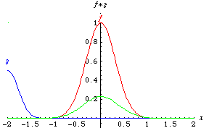
Example convolutions
The sum of the product of 2 functions after 1 is reversed & shifted.
Convolution of two Gaussians

Slide 12
h(n)={2,1,-3,0} x(n)={1,2,3,0}
INTRODUCTION TO DIGITAL SPEECH PROCESSING (ET60007)
© CET, IIT KGP

Slide 13
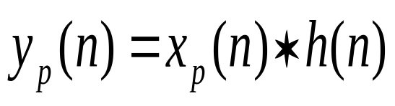
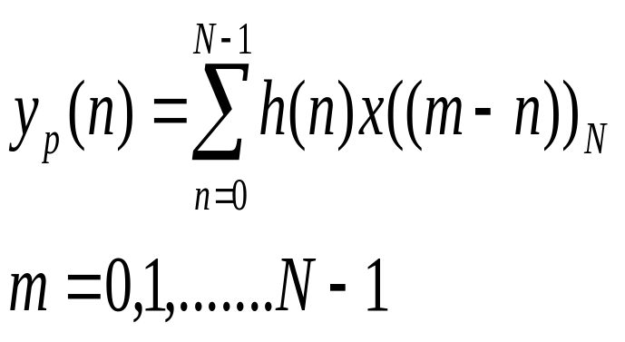
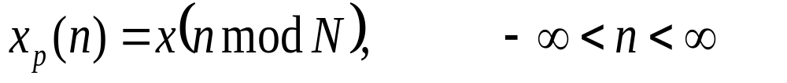
Circular convolution
Circular convolution of x(n) and h(n) is defined as the convolution of h(n) with a periodic signal xp(n) :
where

Slide 14
Introduction
Correlation is a mathematical operation that is very similar to convolution. Just as with convolution, correlation uses two signals to produce a third signal. This third signal is called the cross-correlation of the two input signals. If a signal is correlated with itself, the resulting signal is instead called the autocorrelation.
ES & BM
Signal Processing

Slide 15
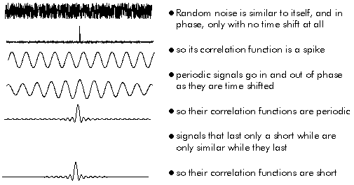
Autocorrelation
  Correlating a signal with itself

Slide 16
The problem
Given a signal of some known shape, what is the best way to determine where (or if) the signal occurs in another signal..?? Correlation is the answer.
ES & BM
Signal Processing

Slide 17
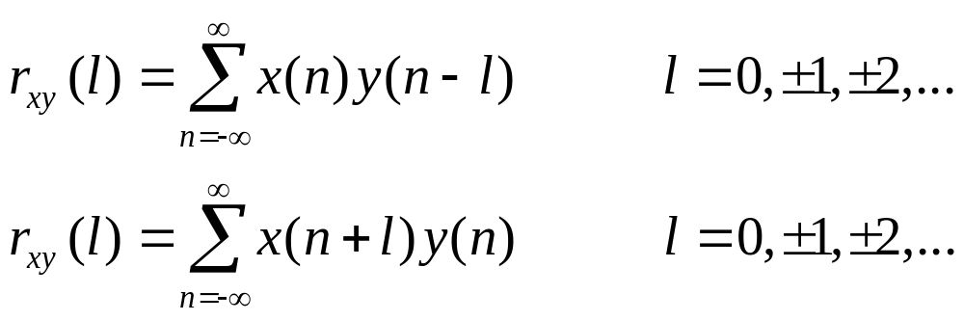
Correlation
Where, r_{xy}(l) is the correlation coefficients

Slide 18
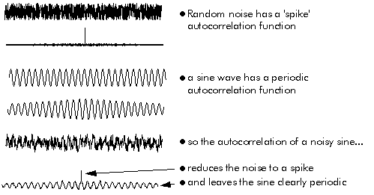
Autocorrelation can be used to extract a signal from noise

Slide 19
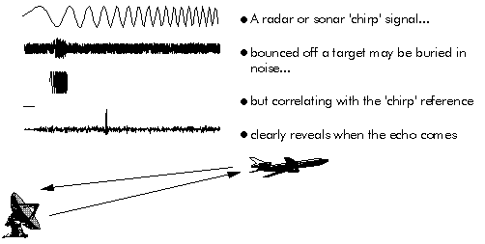
Cross correlation to locate signal
Cross correlation can be used to detect and locate known reference signal in noise

Slide 20
Convolution vs. correlation
Convolution is the relationship between a system's input signal, output signal, and impulse response.
Correlation is a way to detect a known waveform in a noisy background.
The similar mathematics is only a convenient coincidence.

Slide 21
y(n)=-a₁y(n-1)+b₀x(n)+b₁x(n-1)
v(n)=b₀x(n)+b₁x(n-1)
y(n)=-a₁y(n-1)+v(n)
INTRODUCTION TO DIGITAL SPEECH PROCESSING (ET60007)
© CET, IIT KGP

Slide 22
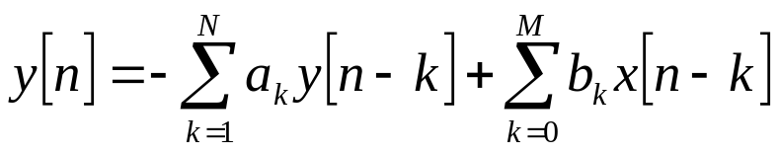
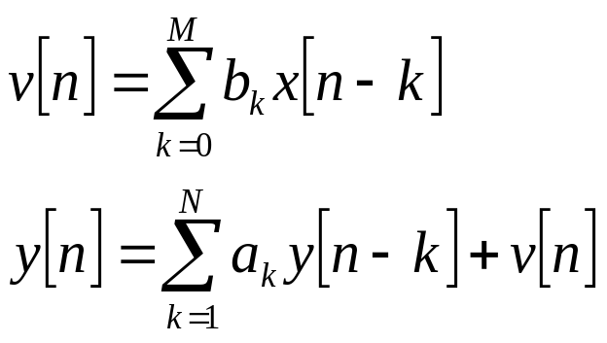
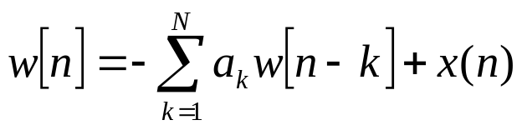
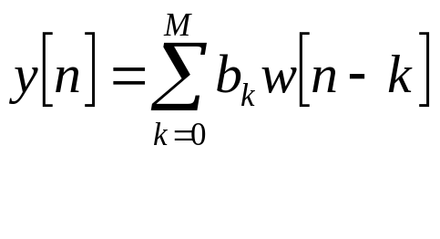
Direct Form I
Transfer function of recursive LTI system
351M Digital Signal Processing
Copyright (C) 2005 Güner Arslan

Slide 23
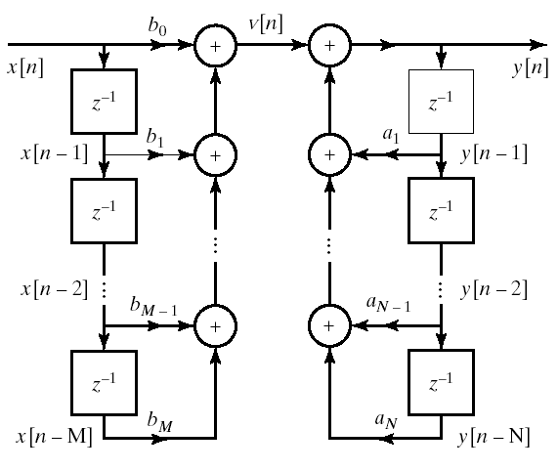
Direct Form I

Slide 24
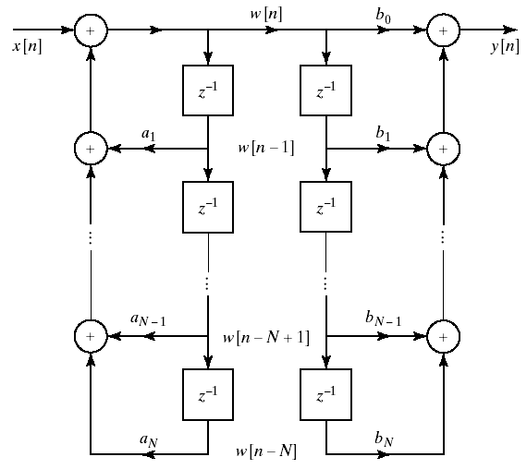
351M Digital Signal Processing
Copyright (C) 2005 Güner Arslan

Slide 25



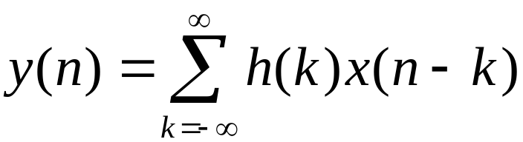
Frequency-Domain Representation of Discrete Signals and LTI Systems
LTI system
complex-valued exponencial signal
LTI system output
impulse response

Slide 26
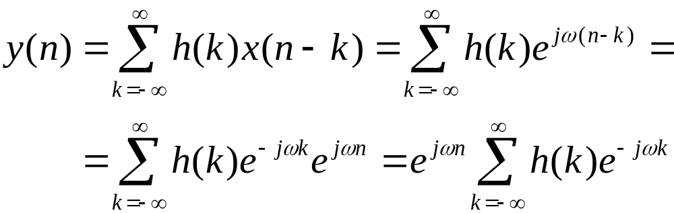

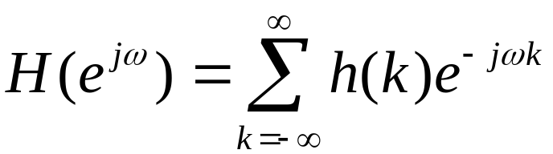
LTI system output:
Frequency response:

Slide 27
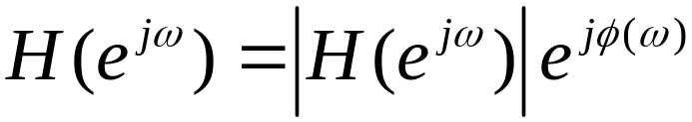
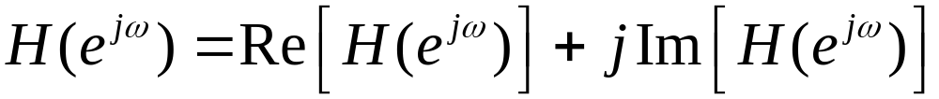
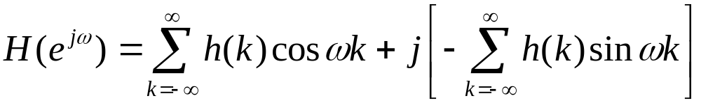
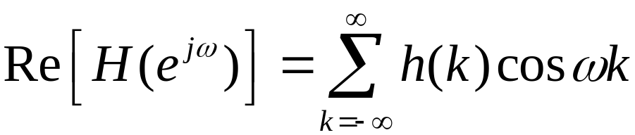
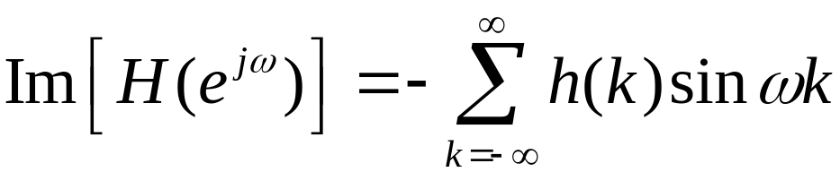

Slide 28
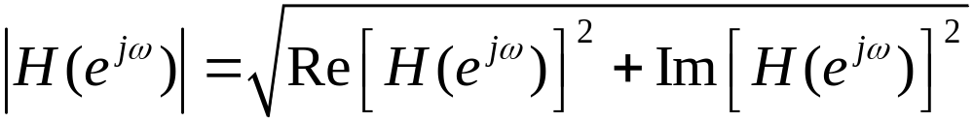
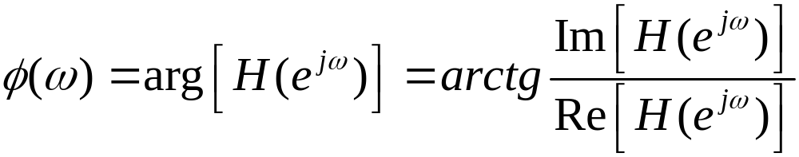
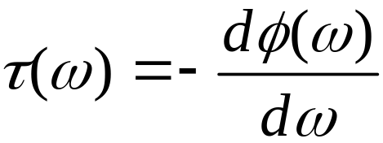
Magnitude response:
Phase response:
Group delay function:

Slide 29
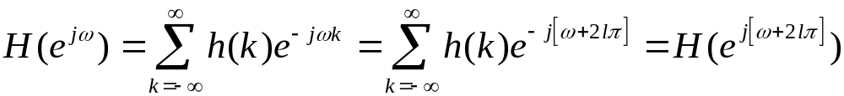


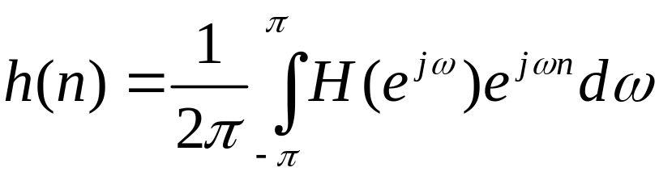
Comments on relationship between the impulse response and frequency response
The important property of the frequency response
is fact that this function is periodic with period .
In fact, we may view the previous expression as the exponential Fourier series expansion for , with h(k) as the Fourier series coefficients. Consequently, the unit impulse response h(k) is related to through the integral expression

Slide 30


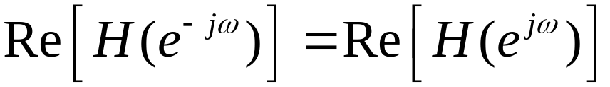
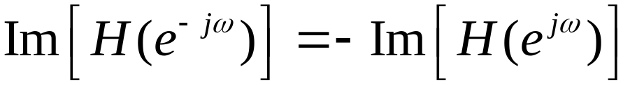
Comments on symmetry properties
For LTI systems with real-valued impulse response, the magnitude response, phase responses, the real component of and the imaginary component of
possess these symmetry properties:
The real component: even function of periodic with period
The imaginary component: odd function of periodic with period

Slide 31
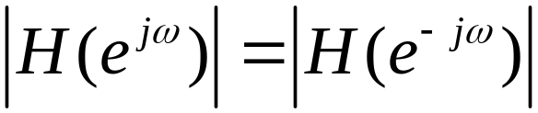
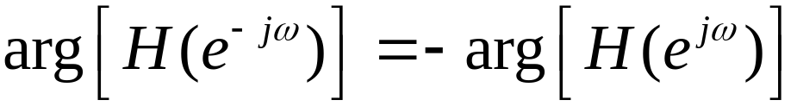
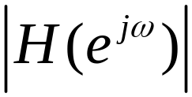


The magnitude response: even function of periodic with period
The phase response: odd function of periodic with period
Consequence:
If we known and for , we can describe these functions ( i.e. also ) for all values of .

Slide 32










Symmetry Properties
EVEN
ODD

Slide 33
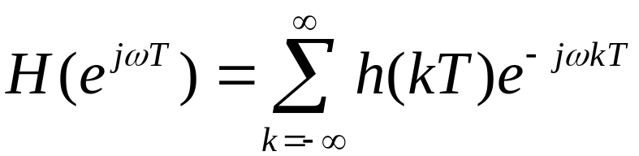
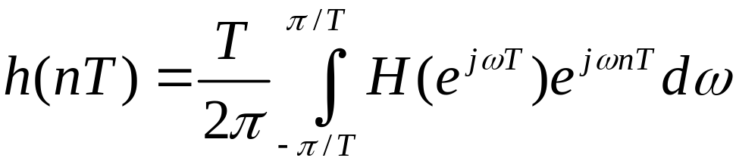
Normalized Frequency
It is often desirable to express the frequency response of an LTI system in terms of units of frequency that involve sampling interval T. In this case, the expressions:
are modified to the form:

Slide 34







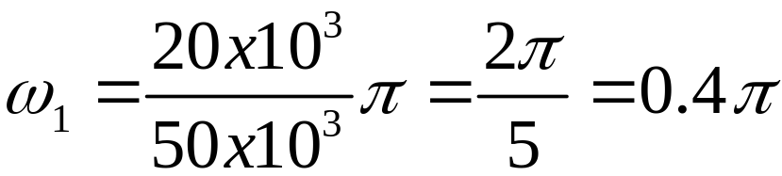

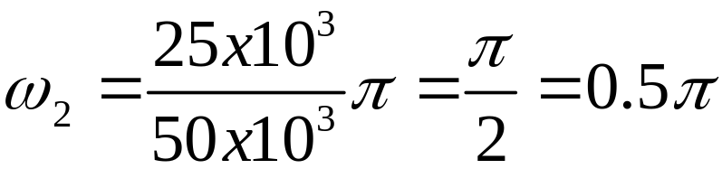

is periodic with period , where is sampling frequency.
Solution: normalized frequency approach:
Example:

Slide 35
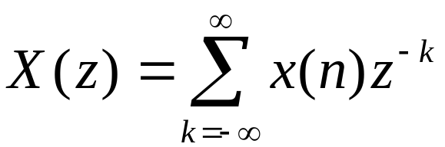

Z -Transform
Definition: The Z – transform of a discrete-time signal x(n) is defined as the power series:
where z is a complex variable. The above given relations are sometimes called the direct Z - transform because they transform the time-domain signal x(n) into its complex-plane representation X(z).
Since Z – transform is an infinite power series, it exists only for those values of z for which this series converges. The region of convergence of X(z) is the set of all values of z for which X(z) attains a finite value.

Slide 36
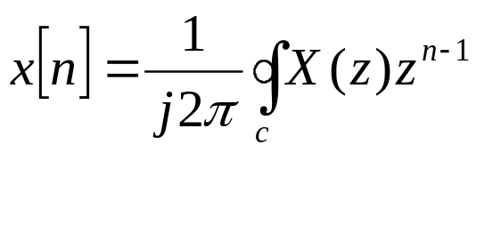
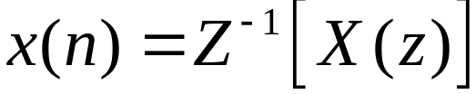
The procedure for transforming from z – domain to the time-domain is called the inverse Z – transform. It can be shown that the inverse Z – transform is given by
where C denotes the closed contour in the region of convergence of X(z) that encircles the origin.

